Slide 1
Orbit COA/GSQA Team Onboarding
4/14/2021

Slide 2

Welcome to Orbit!
We’re glad you decided to join Orbit and we look forward to working with you! Your role is critical to the work we do, and we want to ensure you have the information, access, tools & resources necessary to be successful
This New Employee Assimilation Plan was written for you and also contains information on manager and buddy responsibilities so you have a complete overview of the onboarding & assimilation process.
This guide will help you navigate through your first 6 months at Orbit, and give you a running start to your career with us.
Please use this guide to:
Learn the basics so you can accelerate your assimilation and productivity
Inform you on how to connect and build key relationships within your team, department, and the broader organization
Understand your role and goals, and how you can best contribute to increasing customer trust and competitive differentiation
Help position yourself for long term success at Orbit

Slide 3
New Employee Guide Table of Contents
Getting Started
Understanding the Organization
Training Requirements
Understanding the Process
Tools and Resources

Slide 4
GETTING STARTED
Onboarding and Assimilation

Slide 5
Getting Started Basic Information To Get You Started
Employee Number |  | Name
Email Address |  | Phone Number
Reporting Manager
Resource | Name | Email Address | Phone
Manager
Manager’s Manager
Buddy/Mentor

Slide 6
Globally Required Training – All Employees Within 30 days
n | Training (Required for all employees) | Type | Scheduled | Completed
1 | New Hire Orientation | In person - Theja
2 | Core Values & Norms at Orbit | HR
4 | OQA-1022 & FAIR Overview | In person – Sidharth/Atul
5 | Legal and Ethics Compliance | Online - WBT
6 | RDS Lam NCR | Online - WBT
7 | SAP – PLM & Engineering Dashboard | Online - WBT
8 | Lam Research Quality Management Systems – iQMS & NCi | Online - WBT
9 | SharePoint | Online - WBT
10 | Problem Report(LSR) & iPLM PR | Online - WBT
11 | Intel & LAM – PCS | Online - WBT
12 | Copy Exactly | Online - WBT
13 | Trackwise & KM Matrix | Online - WBT
14 | GSQA Overview, BKMs & OQA Docs | In person - Prashant
15 | Study of RCCAs(projects related) | In person - Manisha
16 | COA | In person – Divesh
17 | eTTTM | In person – Anmol Narang

Slide 7
GSQA / COA / PCS
Customer Request
Tool or part shipment to Customer
COA Delivery
GSQA Part Configuration
Lam Delivery
Supplier Delivery(Part & its data)
Key R&R’s
Need for Scalability
Strategy
Execution
Data reediness for COA request
GSQA Hygiene
New part configuration in GSQA
Manage GSQA Operations
Supplier & SE alignments
On-time customer COA delivery
Manage COA Operations
KCA Admin roles
Manage customer Account teams
Align with different groups to accommodate new customer COA request
NCx reduction
Intel PCS monthly reviews
Customer Parts PCS review
Training on SPC & MSA for Supplier Engineers
Implement SPC at Supplier end
GSQA
PCS
COA

Slide 8
UNDERSTANDING THE ORGANIZATION

Slide 9
Supplier Quality, Assessment & Development (SQAD)
Exempt = 75
Non-Exempt = 9
Total Headcount = 84
LOA (included in above #’s) = 1
Temps (yellow) = 0
Contractor (purple) = 2
Updated 6/10/19

Slide 10
SQAD – Ops - India

Slide 11
Understanding the Process

Slide 12
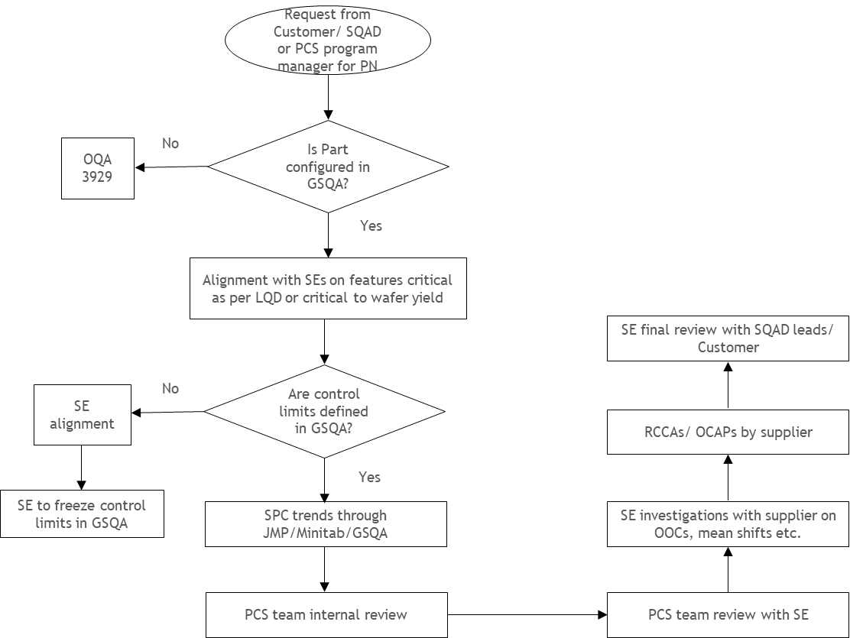
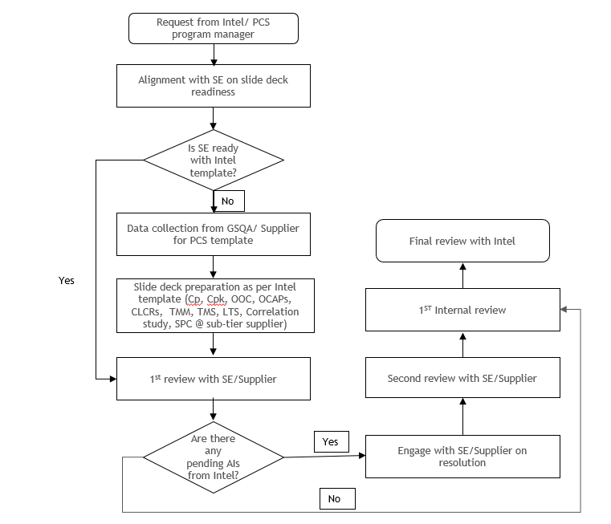
PCS Process Flow
Flow Chart – Lam PCS Program
Flow Chart – Intel PCS Program

Slide 13
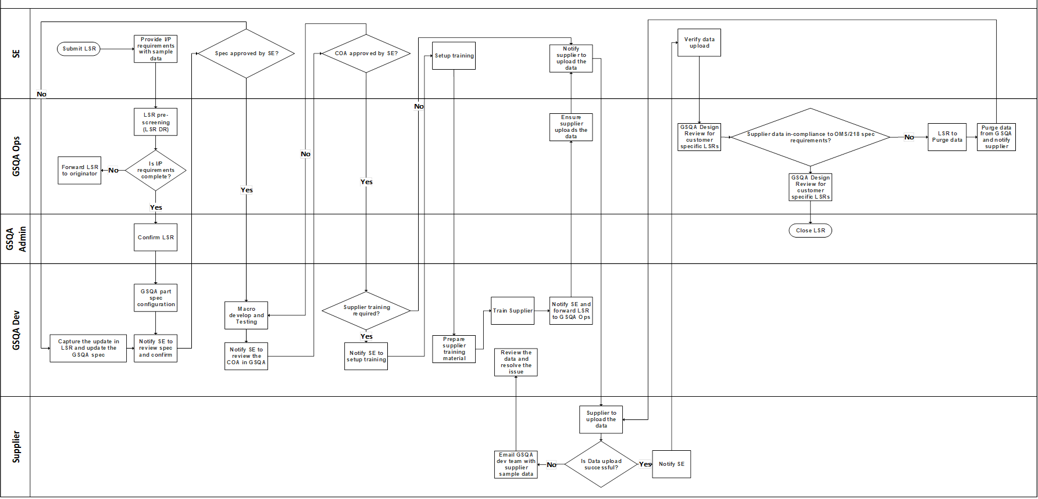
GSQA Process Flow

Slide 14
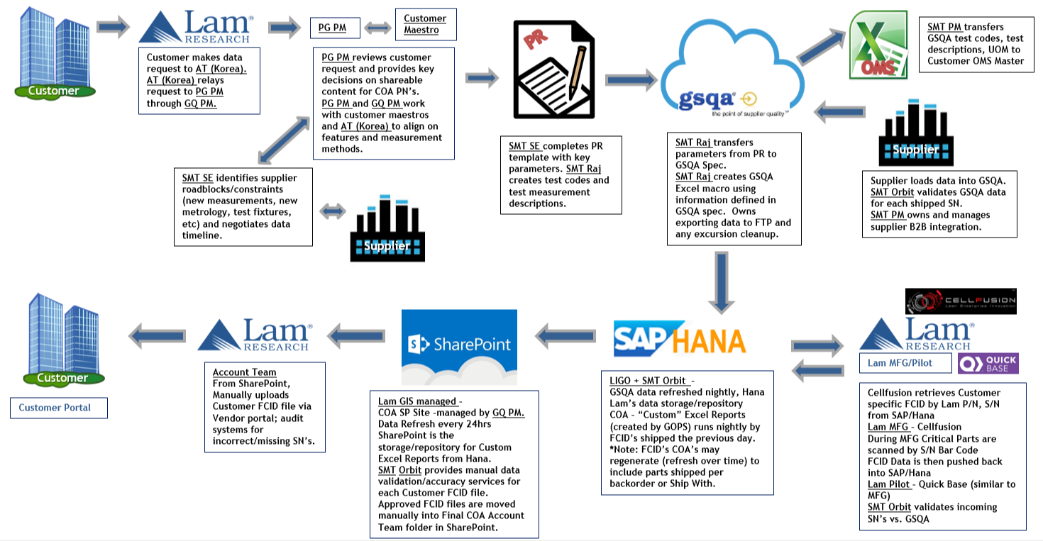
COA Process Flow

Slide 15
TOOLS AND RESOURCES

Slide 16
Tools & Resources SharePoint Collaborative Working Sites
SQAD SP site: https://sharepoint.lamrc.net/dept/GSCM/SMT/default.aspx
SQAD COA site: https://sharepoint.lamrc.net/dept/GSCM/SMT/SMT_Projects/COA/default.aspx
SQAD PCS site: https://sharepoint.lamrc.net/dept/GSCM/SMT/SMT_Projects/PCS_PCFT/default.aspx
SQAD GSQA site : https://sharepoint.lamrc.net/dept/GSCM/SMT/SMTOps/QASoftware/default.aspx

Slide 17
Tools & Resources General Reference Resources
Lam Acronyms: https://sharepoint.lamrc.net/Lists/Lam%20Acronyms/AllItems.aspx
Library: https://thepoint.lamrc.net/sites/lib/Pages/LibraryHome.aspx
MyLam site: http://mylam.com/
Document Viewer: http://lamwebdrawings.dhcp.lamrc.com/lamwebfiles.asp
Part Finder: http://kmmatrix.fremont.lamrc.net/
DDS2000 : Saved in excel.

Slide 18
Tools & Resources SAP Transaction Codes
MD04: Stock/Requirements
CS03: View Material Bom
CS63: View Sales Order OrderBOM
CS15: Where-Used
CS14: BOM to BOM Comparison
MMBE: Display Material Availability thru all plants
MM03: Display Material
ZR409: List SBM, Buyer Information
ZCS1: Costed BOM
ME23N: Display Purchase Order
MELB: ERF – PO History
ME2M: P/N – PO History
ME2L: Vendor Code – PO History
ZR083: Lam P/N – MPN
ZR004: MPN – Lam P/N & MFR
Z080: DCN History
CC03: DCN Details
ZMATTC: Target Material Cost
MK19: Vendor Info
MK03: Vendor Info
ZR423: Info Record Quote
ME0M – Approved Supplier Info
FYI – Highlighted ones most frequently used.

